Slide 1
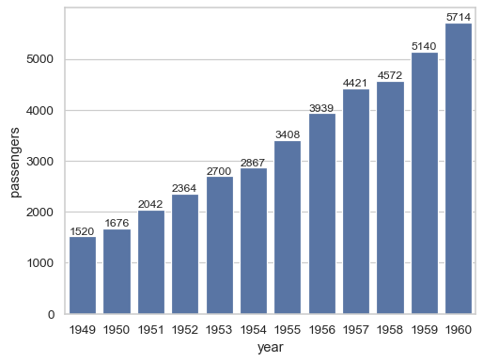
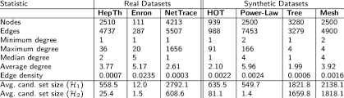
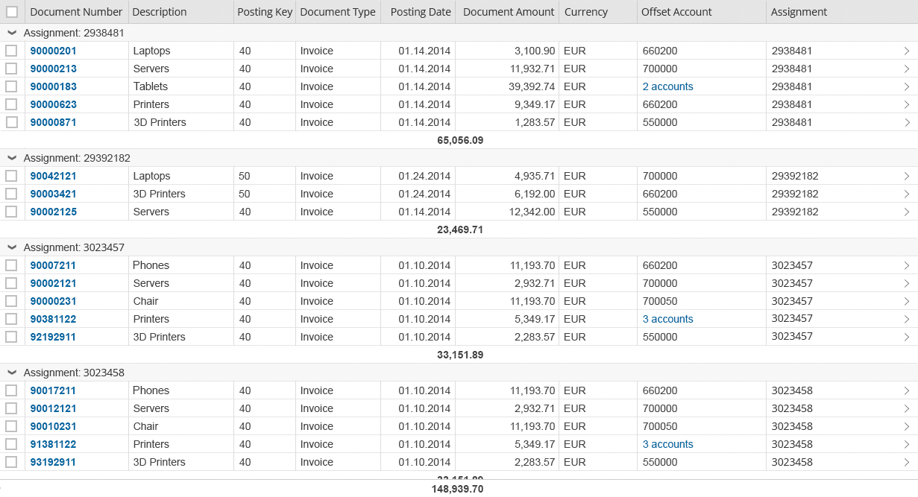
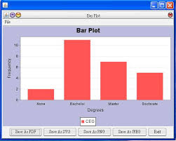
Poster Title
David Jiang¹, Emily Carlos² (Author Names, the last name shall be your mentor)
¹ Diamond Bar High School, Diamond Bar, CA 918765
²Department of Chemistry, University of California-Los Angeles,
Your high school Logo
Research Institute Logo
ABSTRACT
RESULTS
Figure 2: Label title here.
200-300 words, summarize the following:
Objectives: Brief introduction to your topic and aims and hypothesis.
Methods: Procedures used for your research study
Results: Only pertinent results need to be included.
Conclusions: Final remarks on your study. Future implications.
In this section briefly describe the problem, which dataset or data you utilized, your population, your aims and hypothesis. What do you hope to accomplish by this study (relevance, research gap).
In the following bullet points, list anything significant we need to know about the topic. Present global, national, or regional stats (depending on your study population) and other research in the field and how that is comparable or different from what you predict.
Write something important here.
Write something important here.
Write something important here.
Graphs/and or tables can be included here as well. Use same formatting as mentioned in the results section.
Insert Tables and Figures (in the form of graphs, pie charts, etc.) here from your analysis. The first table will be a descriptive table (N, M, SD). You can add figures to this also. The following tables and figures will be your analytical results.
Table 1: Descriptive Statistics on ……(use regular size text)
Footnotes: Use smaller size text. Italicize. You would mention briefly what we are seeing in the table and any results if applicable. For descriptive statistics you do not need footnotes unless there is something significant you would like to highlight.
Table 2: Analytical tables……(use regular size text)
Footnotes: Use smaller size text. Italicize. You would mention briefly what we are seeing in the table and any results if applicable.
Figure 1: Label title here.
Footnotes: Use smaller size text. Italicize. You would mention briefly what we are seeing in the figure and any results if applicable.
CONCLUSIONS
INTRODUCTION
Mention your main results in bullet form.
Also mention if what you found is similar to or different from other research out there.
What do you conclude?
Limitations: what are some study limitations. These are not personal grievances such as lack of time, lack of resources.
Rather study related limitations such as: not enough participants to achieve significance, there could have been recall bias by study participants, etc.
ACKNOWLEDGEMENTS
This poster template is intended as a general guide for your research presentation. As there are many disciplines, not all aspects of this poster might be applicable to your research. Format your materials accordingly. Only significant information from each section should be on the poster. During presentations, you will relay the other information orally.
(Please do not change the font size or poster size, as there needs to be consistency when printing).
METHODS
Only bullet points are necessary in this section.
Mention your population statistics, dataset used (restricted, open access) (work with other institutions? IRB approval? From where?
Brief Procedures
Data analysis: Which analysis did you use? (ex. multiple linear regression was used to test the association between population size and disease occurrence). Which software (name, version, date) (ex. SPSS, version 25, 2019)
REFERENCES
Since references would mostly only be utilized in the introduction and conclusion, then max 5-7 highly study relevant references should be added here. Use Vancouver style citations in your text.
Vancouver style: use of superscript with your citations (google it!).
A few sentences on who you would like to acknowledge. Use first last name, degree. Ex. John Doe, PhD. Also mention any institutions you would like to acknowledge (CUSM?)

